Slide 1
Droughts
Silvia Caldararu
Email: caldaras@tcd.ie

Slide 2

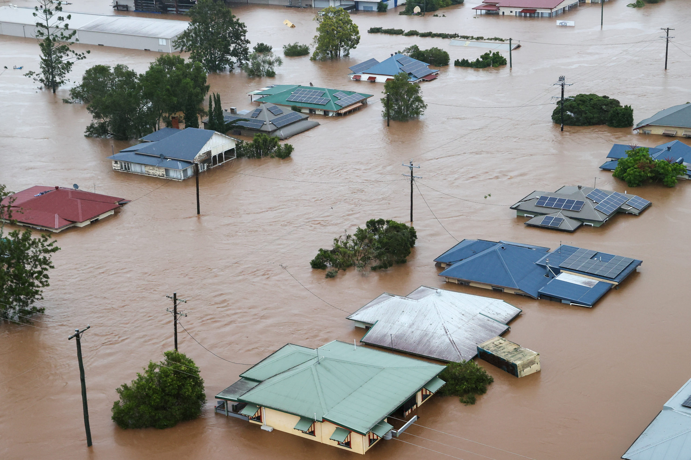
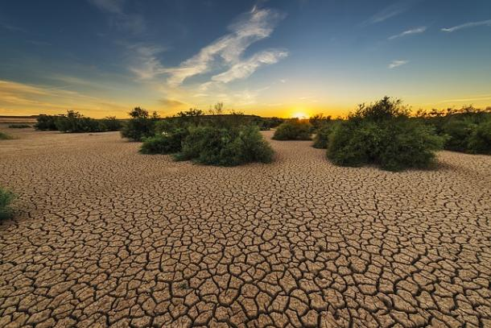
Water extremes

Slide 3
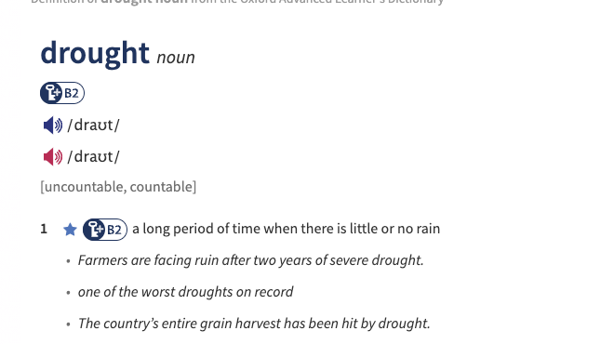
What is a drought?

Slide 4
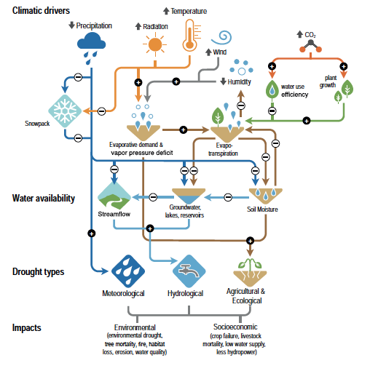
Factors that affect drought frequency and intensity
Notes:
IPCC WG I, chapter 8, figure 8.6

Slide 5
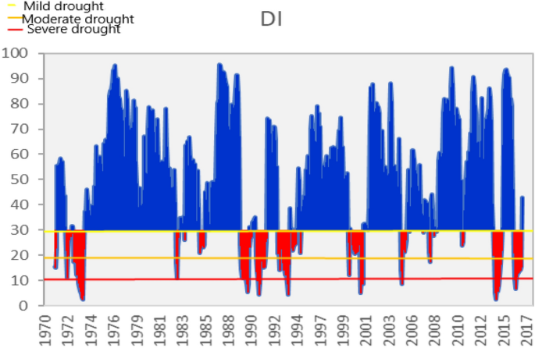
Meteorological drought
Prolonged absence or reduction in precipitation

Slide 6
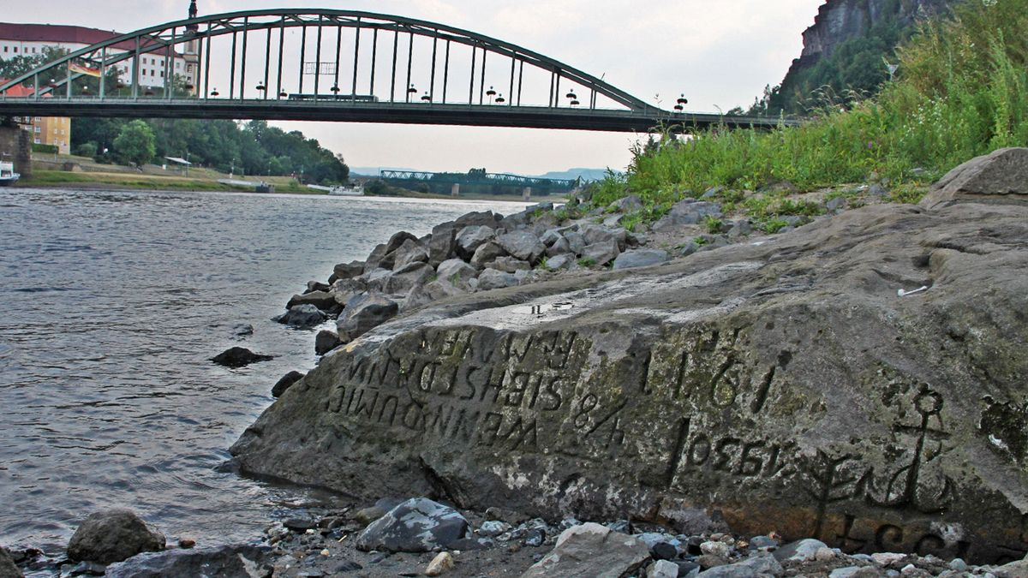
Hydrological drought
Reduction in groundwater and/or surface water levels

Slide 7
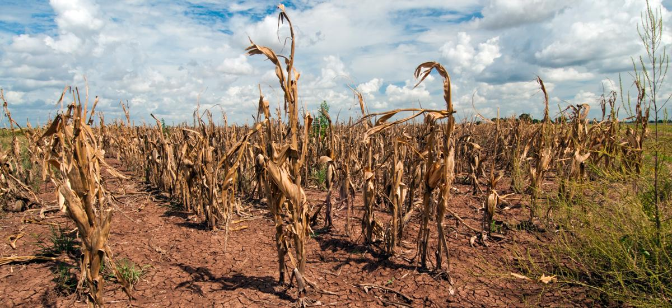
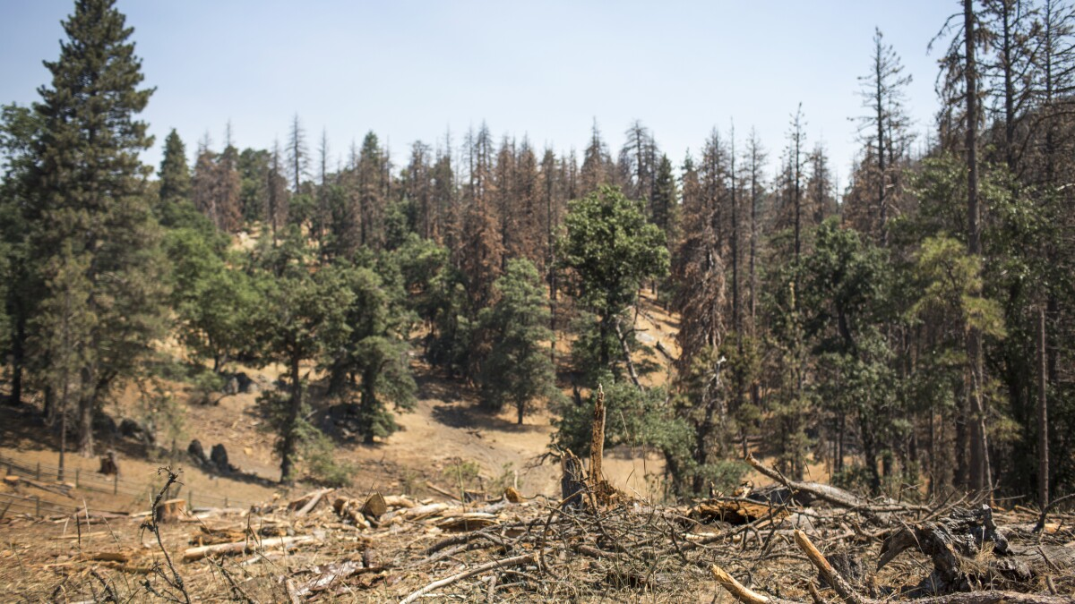
Agricultural or ecological drought
Meteorological or hydrological drought that results in crop damage and yield loss

Slide 8
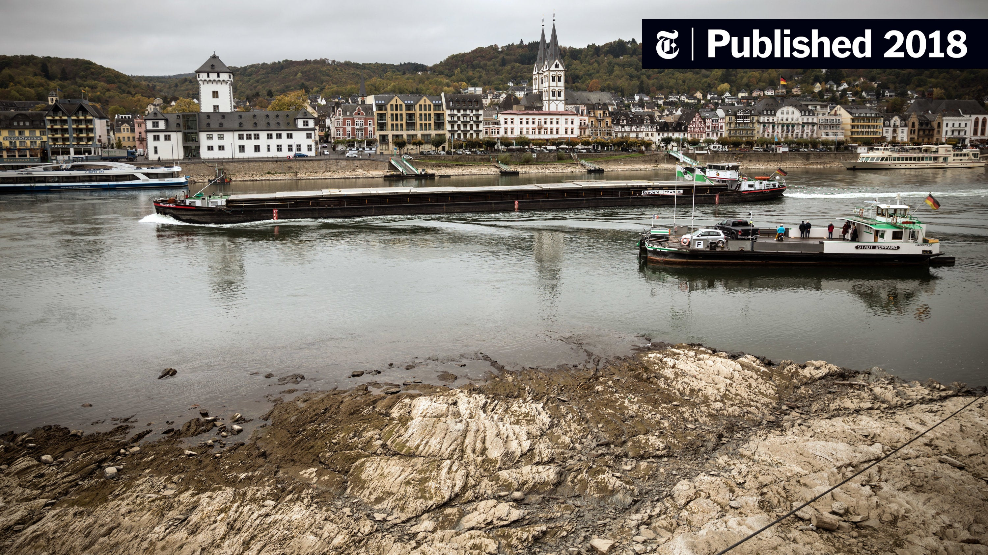
Socio-economic drought
Meteorological or hydrological drought that results in socio-economic damage

Slide 9
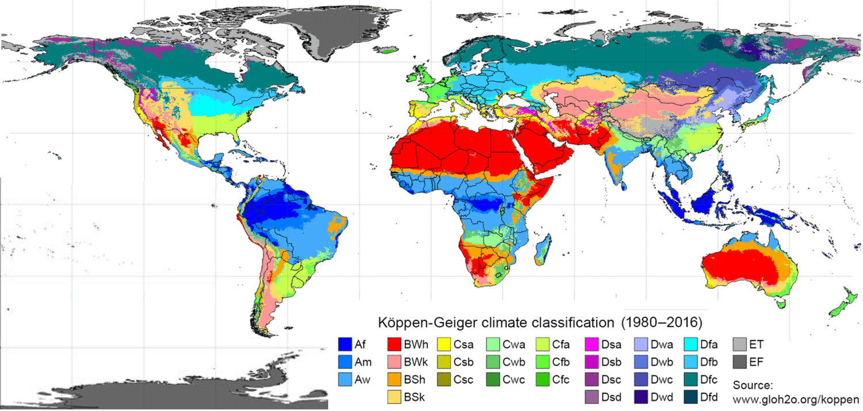
Droughts are not the same as dry seasons
Certain areas of the world have a dry or seasonally dry climate
Droughts are always calculated based on average historic climate data at the time of year

Slide 10
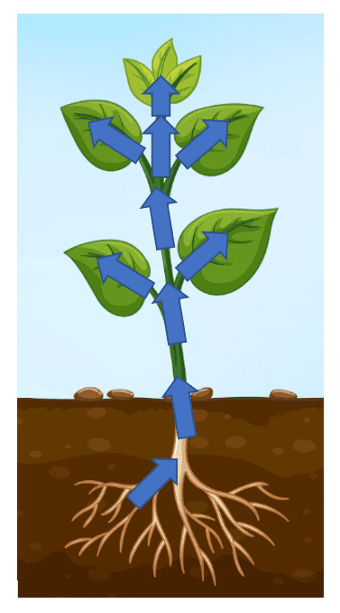
Drought effect on plants
Plants take up water from the soil, transport it through their stem and lose it through transpiration in the leaves
Water flow needs to be sustained to maintain turgor (tension in the stem) and nutrient uptake
Breaking the water stream can lead to cavitation (damage to transport vessels)

Slide 11
Drought effect on plants
Plants have control of water loss through closing their stomata
But there is a trade-off with CO₂ uptake and photosynthesis

Slide 12
Plant strategies in response to drought
Maintain water flow
Keep stomata open
Continue photosynthesis
Fix transport vessels when they get damaged
Potential death from vessel damage and hydraulic failure
Reduce water flow
Close stomata
Reduce photosynthesis
Transport vessels do not get damaged
Potential death from carbon starvation

Slide 13
Factors that affect drought frequency and intensity
Notes:
IPCC WG I, chapter 8, figure 8.6

Slide 14
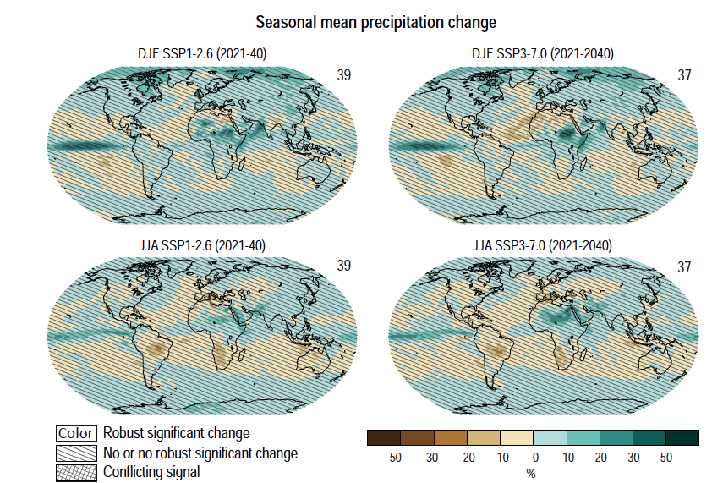
Near-term global precipitation change
Much higher uncertainty than temperature, across the globe
Drying in the Amazon corresponding to projected temperature increase
Notes:
IPCC WGI, chapter 4, figure 4.13

Slide 15
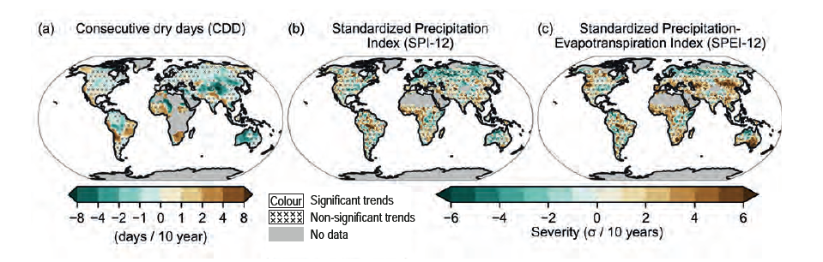
Observed recent changes in drought intensity and duration
Notes:
IPCC WGI, chapter 11, figure 11.17

Slide 16
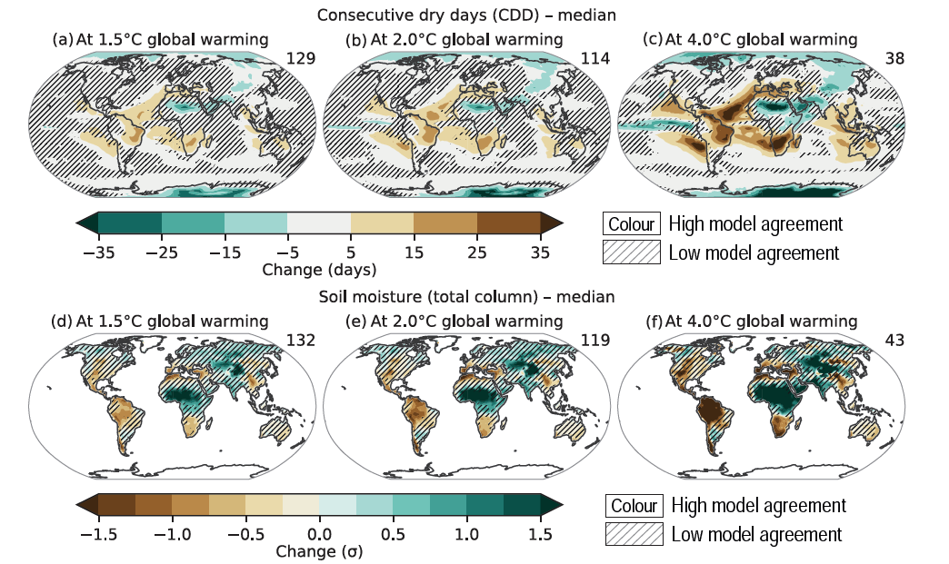
Future changes in drought intensity and duration
Notes:
IPCC WGI, chapter 11, figure 11.19

Slide 17
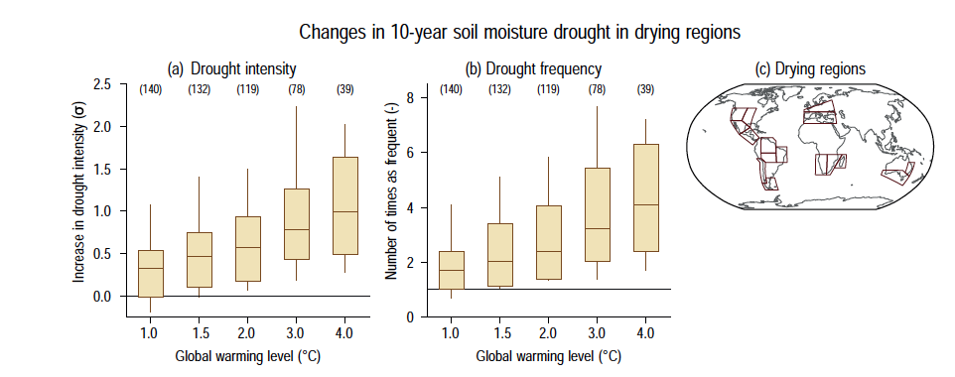
Predicted changes in drought intensity and frequency
Notes:
IPCC WGI, chapter 11, figure 11.18

Slide 18
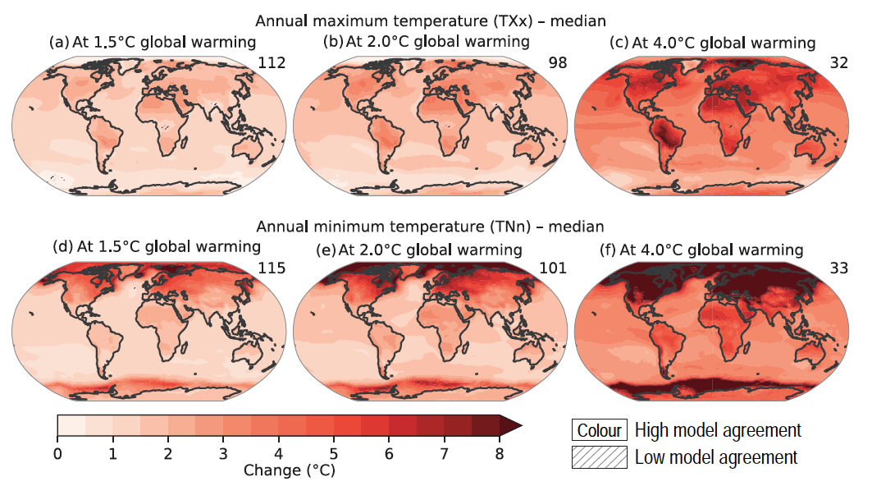
Compound events: droughts and heatwaves
Notes:
IPCC WGI, chapter 11, figure 11.11

Slide 19
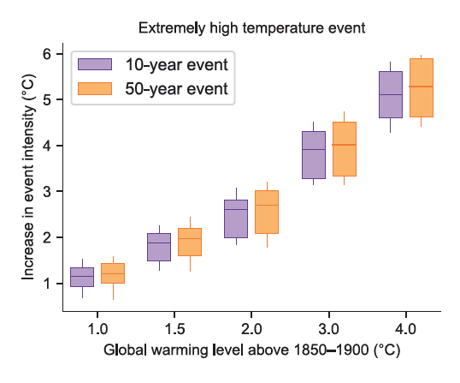
Compound events: droughts and heatwaves
High temperatures can further exacerbate meteorological droughts through increased evaporation
Heat stress can also affect biological function
Notes:
IPCC WGI, chapter 11, figure 11.12

Slide 20
Impacts: decline in productivity
Decrease in photosynthesis due to closing of stomata
Decrease in growth or plant death
Both crops and natural ecosystems

Slide 21
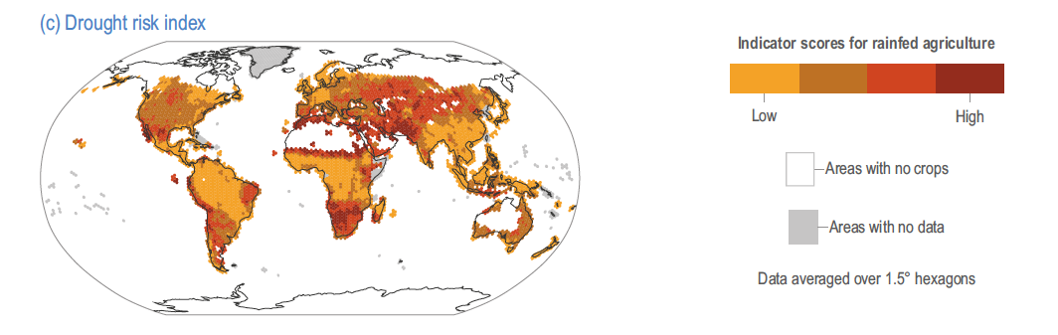
Drought risk to crops
Notes:
IPCC WG II, chapter 5, figure 5.5

Slide 22
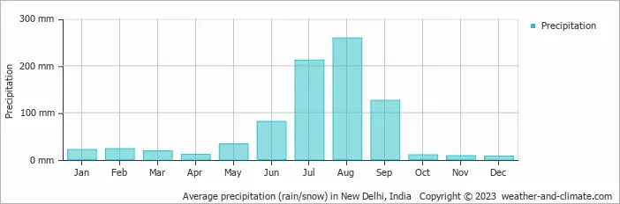
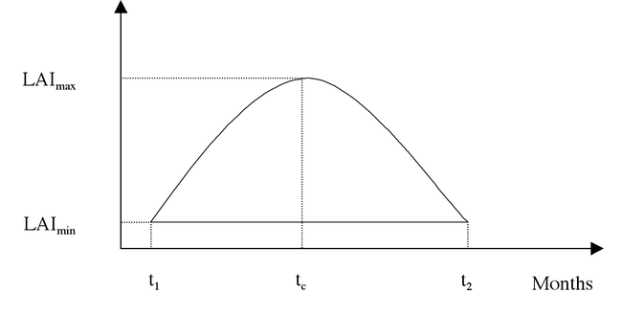
Timing of droughts matters for biological activity
Plants are more vulnerable to drought if they don’t have enough resources to deal with the carbon loss

Slide 23
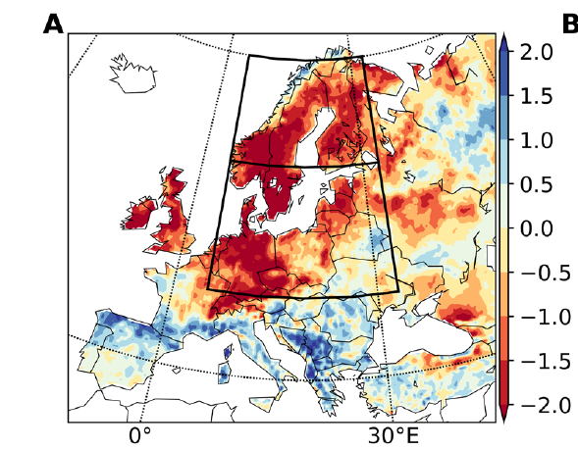
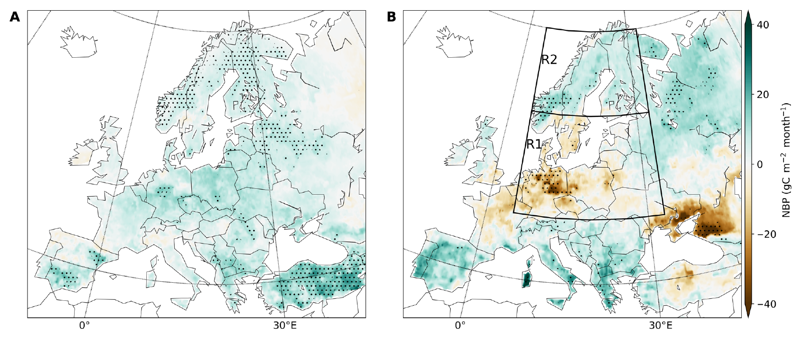
Droughts can also mean more productivity
European drought 2018-2019
Parts of Europe took advantage of the warm, sunny spring (A) and carried on increased growth into summer (B)
Soil moisture anomaly
Notes:
https://www.science.org/doi/full/10.1126/sciadv.aba2724

Slide 24
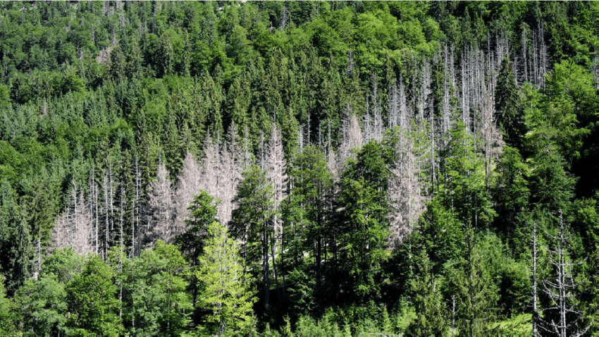
Increased vulnerability: drought + insect attack
Plants use resources to defend and recover from an insect attack
Prolonged drought and heat stress causes a decrease in carbon uptake and reserves
Droughted trees are more vulnerable to insect attacks, leading to increased mortality

Slide 25
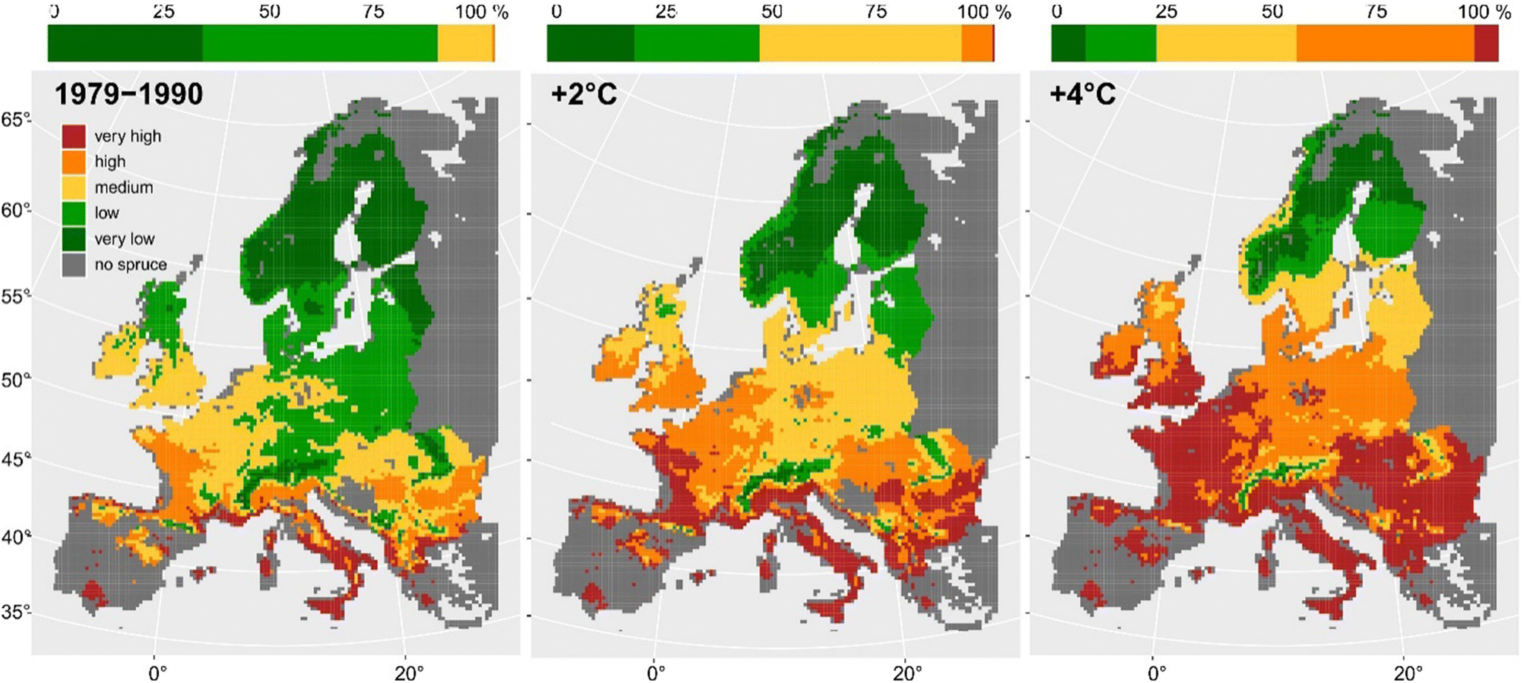
Increased vulnerability: drought + insect attack
Different species can have different range shifts, altering their interactions
Example – bark beetles shift their ranges north exposing new ecosystems to their effects and affecting plants that are not adapted to their attacks
Probability of bark beetle attack to pine stands
Notes:
https://link.springer.com/article/10.1007/s40725-021-00142-x

Slide 26
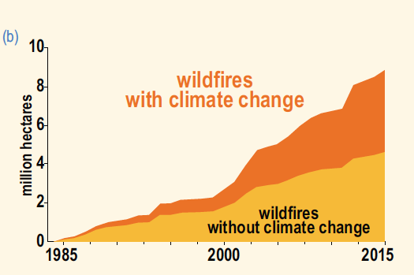
Increased vulnerability: drought + wildfires
Wildfires occur naturally but can potentially increase with climate change
Can affect already vulnerable and unstable ecosystems
Western USA
Notes:
IPCC WG II, chapter 2, figure FAQ 2.3.1

Slide 27
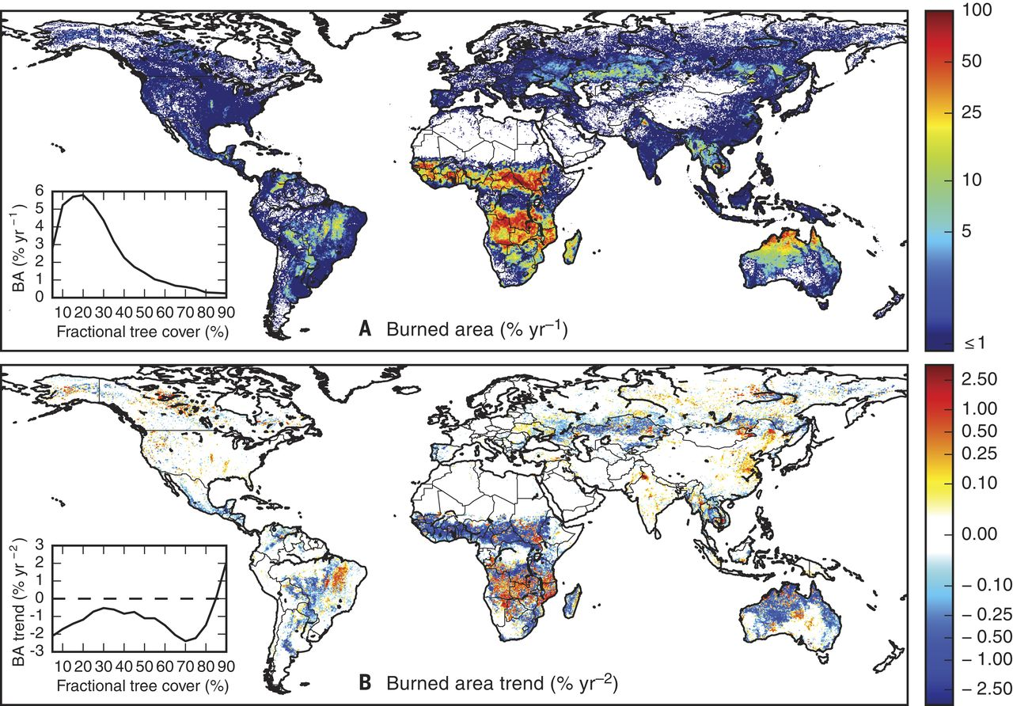
Trends in burned area
Burned area has on average decreased over the last decades due to management activities
But frequent more intense fires and fires in area not previously exposed
Note log axis in bottom panel – some of the big changes are big
Notes:
https://www.science.org/doi/10.1126/science.aal4108

Slide 28
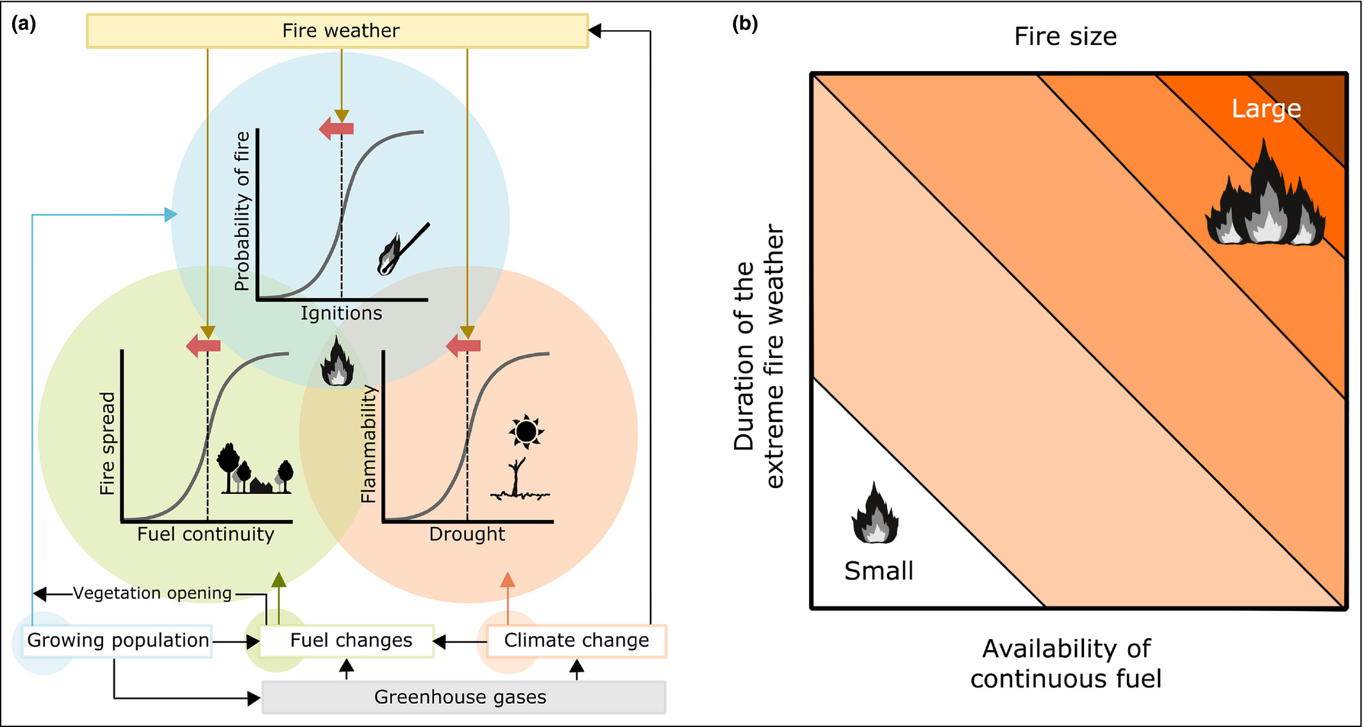
Fire intensity and duration
Depends on fuel availability i.e. dried plant material
Feedback with drought damage and species outside their climate range

Slide 29
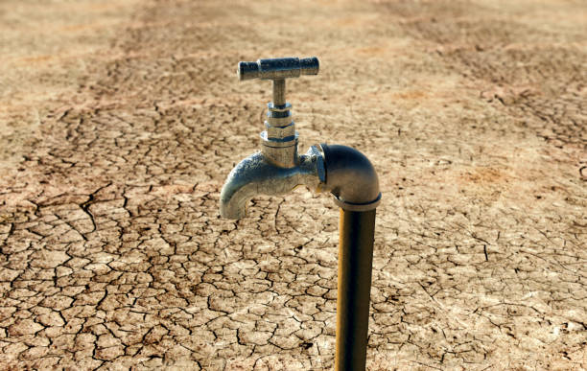
Impacts: freshwater availability
Low river and groundwater levels mean less water available for human consumption
Implications for human health

Slide 30
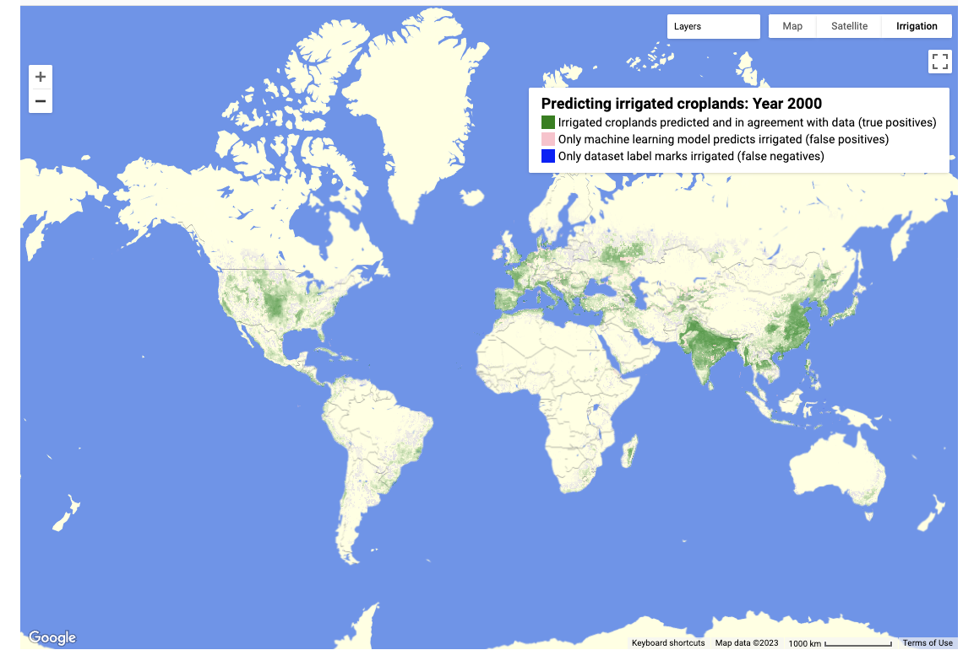
What can we do? Agricultural management
Irrigation – implies there is water available
Improved soil structure to hold rather than lose water
Notes:
FAO data

Slide 31
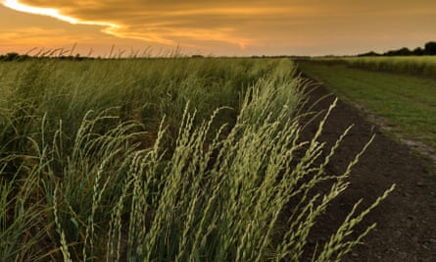
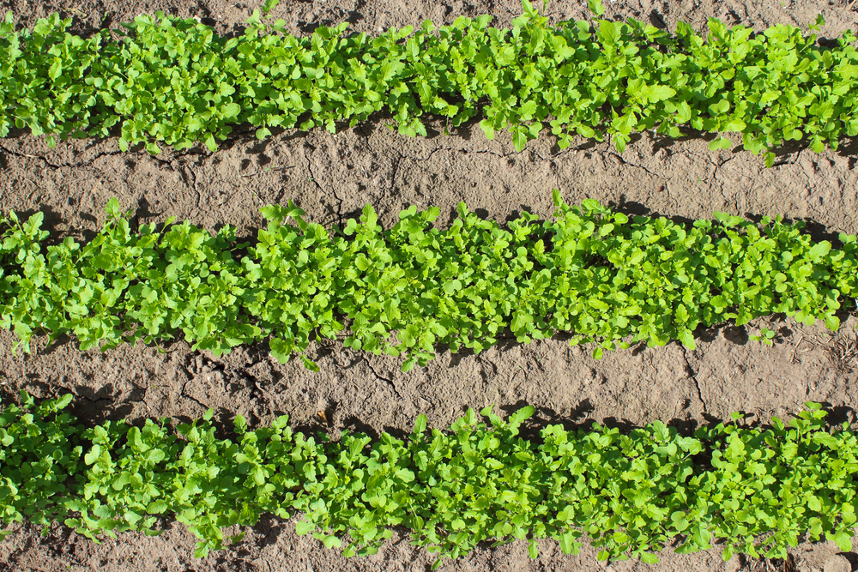
What can we do? More resistant crops
Some plant varieties are naturally more resistant to drought than others based on the climate they are adapted to
We can also breed or modify our crops to be more drought resistant

Slide 32
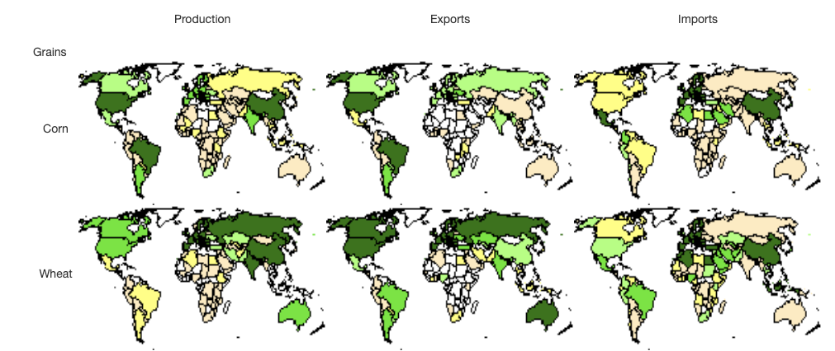
What can we do? More resilient food supply chains
Regional droughts can have impacts on global food supply
Multiple sources and flexible supply chains are needed
Notes:
https://ipad.fas.usda.gov/ogamaps/Default.aspx

Slide 33
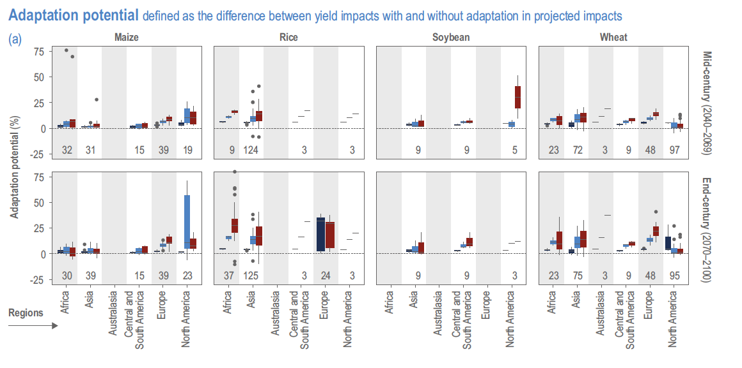
Notes:
IPCC WG II, chapter 5, figure 5.9

Slide 34
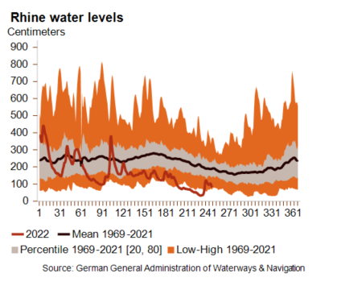
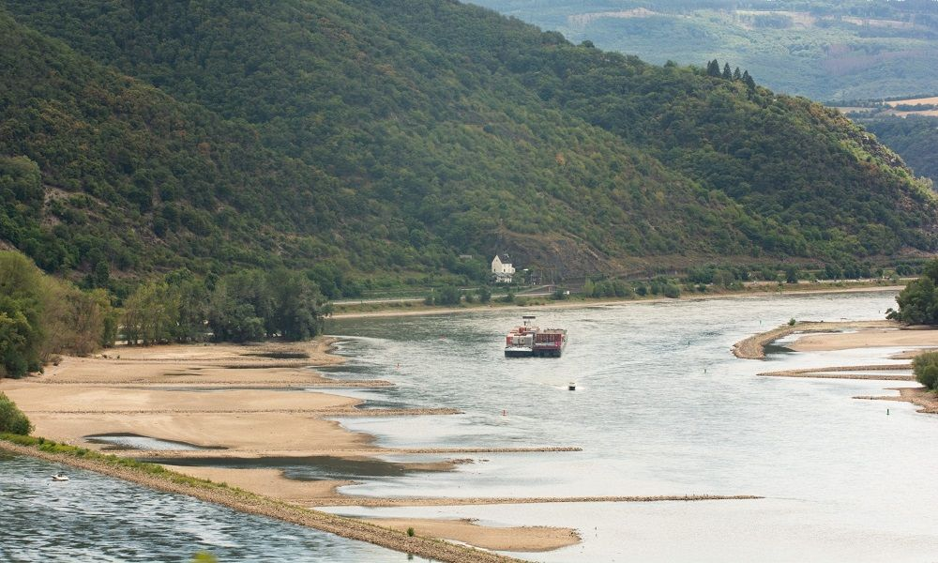
Impacts: transport
River transport still widely used
Low water levels mean large boats cannot navigate
Adaptation: diverse/backup modes of transport

Slide 35
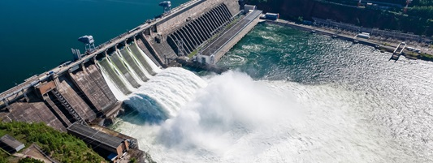
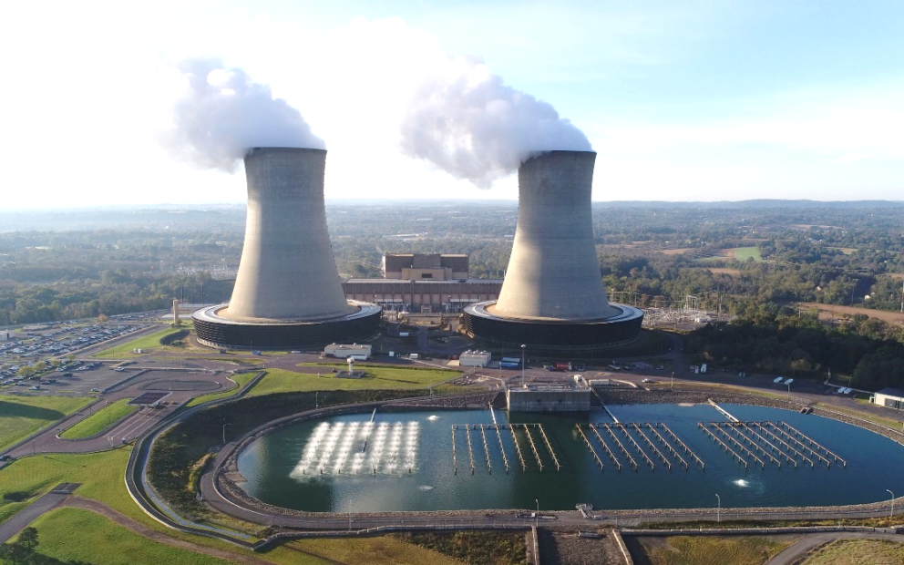
Impacts: energy
Hydroelectric power relies on sustained water levels
Nuclear power relies water for cooling reactors
Adaptation: diverse energy sectors

Slide 36
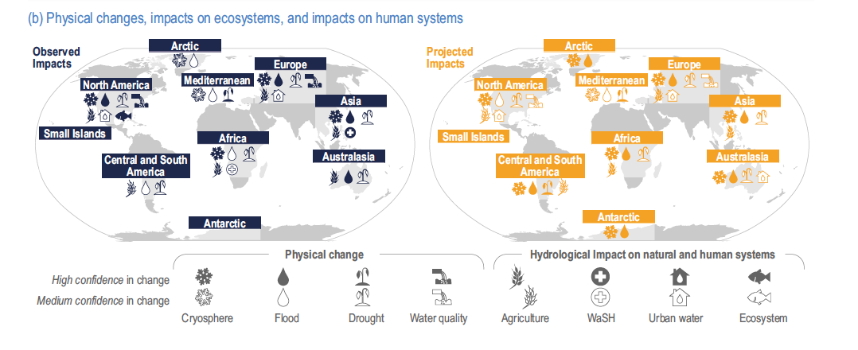
Summary: impacts of changes in the water cycle

